Slide 1
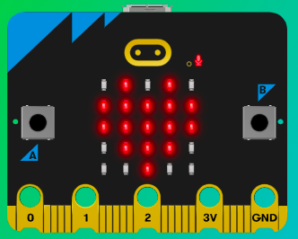
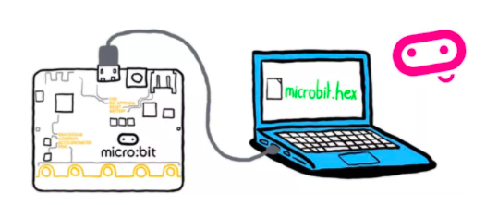
MicroMakers!
KIDS’ MAKER CLUB OF WASHINGTON, DC
Meet Up #3

Slide 2
RECAP!
Inputs, Outputs, Processors, Programs
Project Steps
Animation
Notes:
LEDs, Buttons, Light Sensor

Slide 3
RECAP: MAKER STEPS!
Follow these steps for each of our projects
Project Description
How Does it Work?
Read the Code and Start Making!
Share it!
Improve it!

Slide 4
PART I: Sunshine
Let’s Review LEDs and Animation!

Slide 5
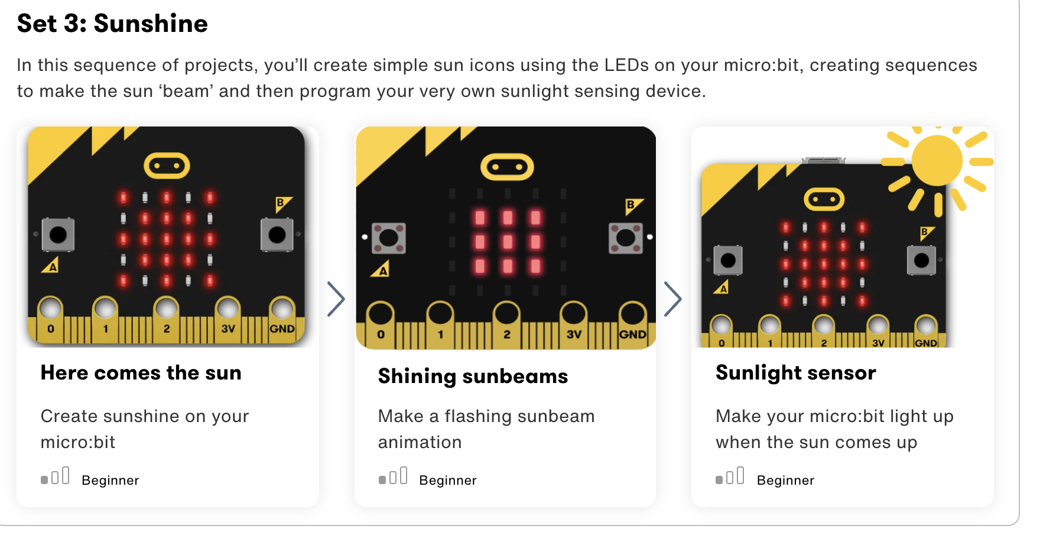

Slide 6
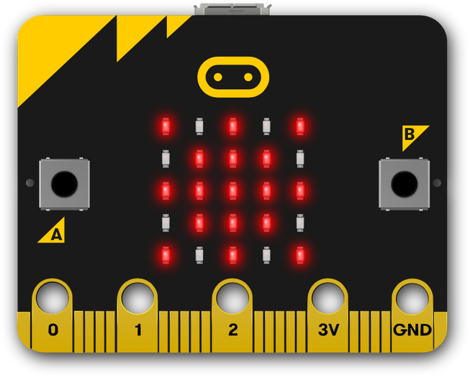
Step1: The Project My Only Sunshine
What is it?
Create your own sun icon for your micro:bit.
What do I need?
micro:bit (or MakeCode simulator) with USB
MakeCode or Python editor
Battery pack (optional)
Graph paper for making your own designs (optional)

Slide 7
Step 2: How Does it Work?
The micro:bit has lots of pictures built in, but sometimes you’ll want to add your own.
This program creates a sun image using the micro:bit display's 5x5 grid of LEDs.
Computers, phones and tablets use small pictures to represent things and ideas using a small number of dots, or pixels, as icons or emojis

Slide 8
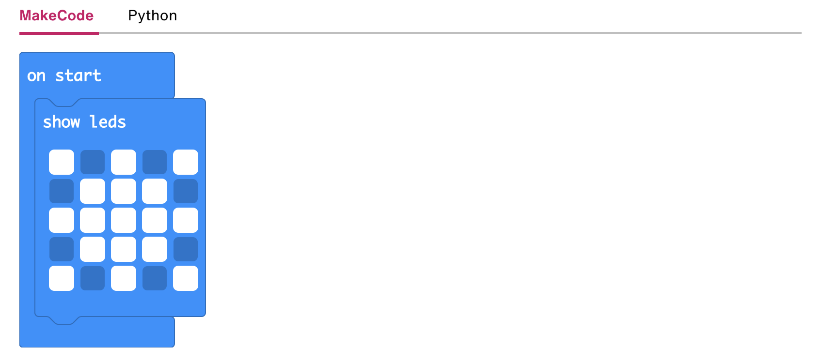
Step 3: Read the Code and Start Making!

Slide 9
Step 4: Share Your Creation!

Slide 10
Step 5: Improve It
Draw your own version of the sun, or a star or moon.
Make a sun appear if you press button A, a moon if you press button B.
Use a loop to make the sun blink or rise.
In Python, use a range of numbers (not just 9) to show the sun’s rays getting dimmer as they get further from the center.

Slide 11
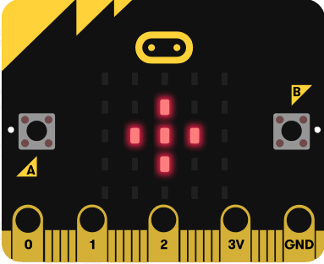
Step1: The Project Sunbeam Animation
What is it?
Use the sun icon from the Here comes the sun to make a sunbeam animation.
What do I need?
micro:bit (or MakeCode simulator) with USB
MakeCode or Python editor
Battery pack (optional)
Graph paper for making your own designs (optional)

Slide 12
Step 2: How Does it Work?
The program shows a sequence of sun pictures on the LED display based on the one we made in the Here comes the sun project.
It waits 500 milliseconds (half a second) between showing each image to allow you to see it before displaying the next.
The sequence makes an animation of sunbeams coming from the centre of the sun.
The sequence repeats for as long as your micro:bit has power because the instructions are inside a forever, or infinite, loop.
Computers are often used to help animators make cartoons and films, creating an illusion of movement by showing a sequence of slightly different images one after another.

Slide 13
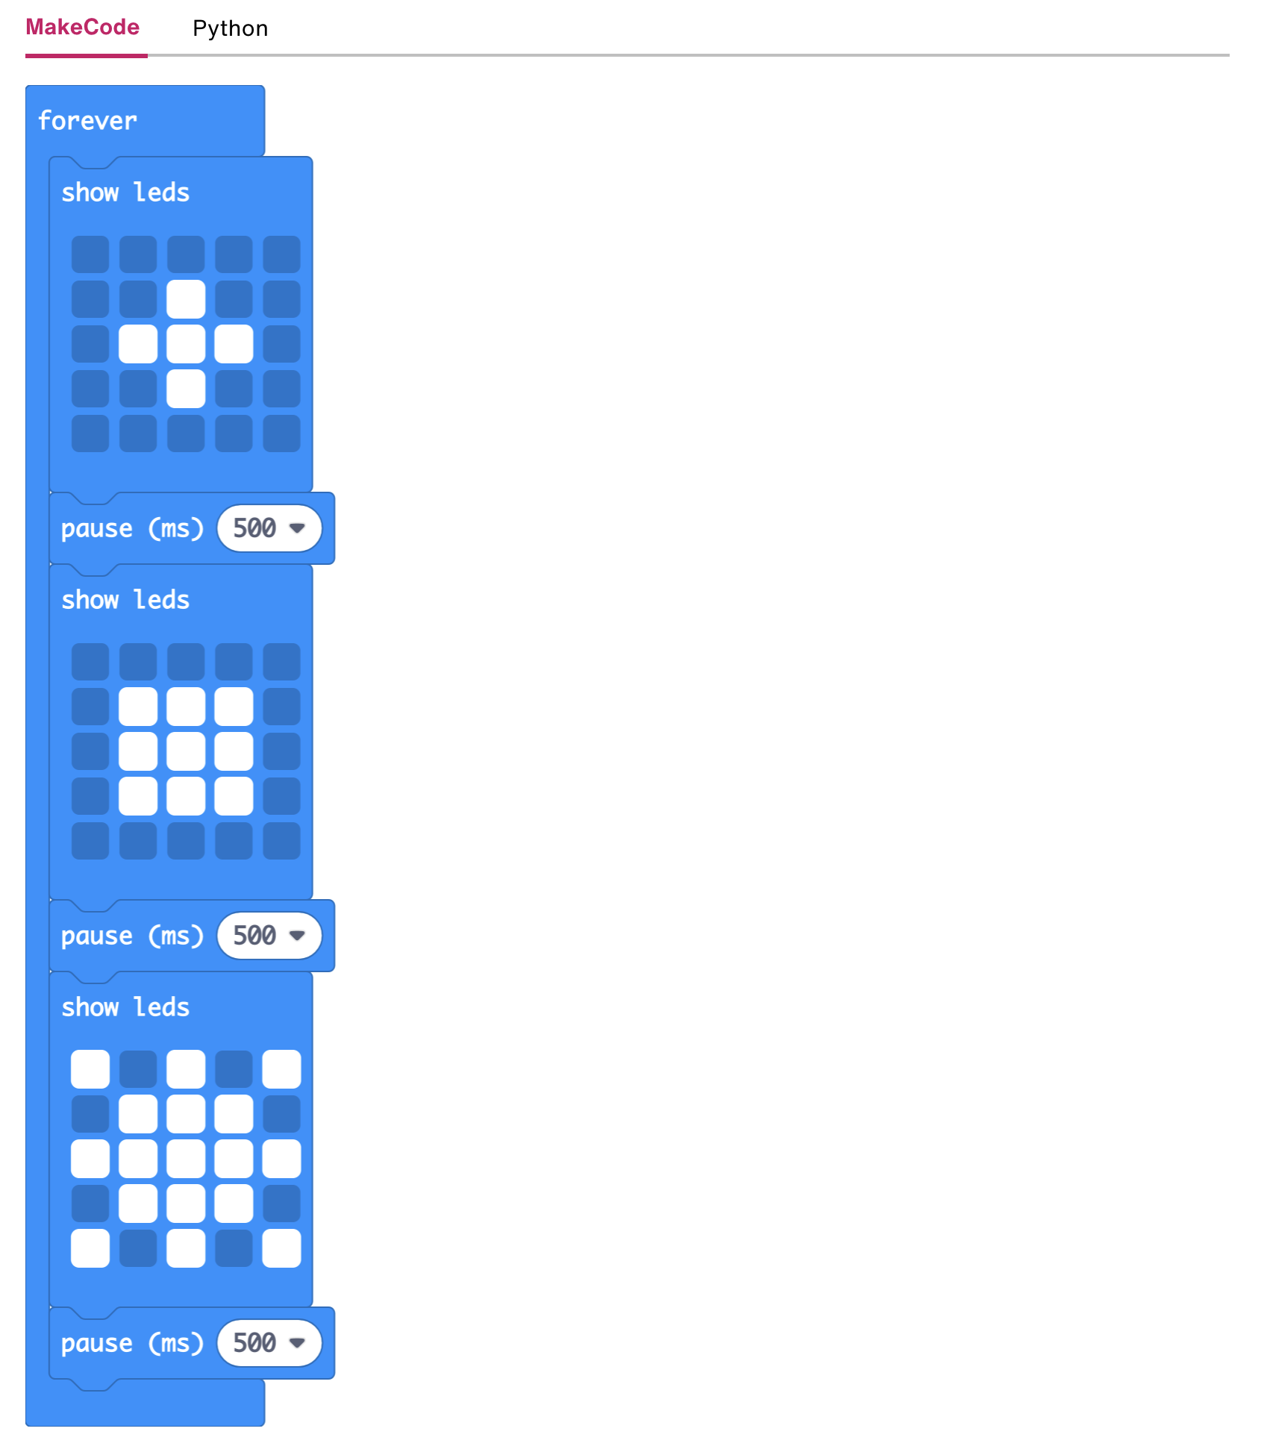
Step 3: Read the Code and Start Making!

Slide 14
Step 4: Share Your Creation!

Slide 15
Step 5: Improve It
Speed up or slow down the animation by changing the delay of 500 milliseconds.
Use your own design for the sun and its rays.
In Python, use a range of numbers from 1 to 9 to show the sun’s rays getting dimmer as they get further from the center.

Slide 16
BREAK!
20 hops on one foot, please!

Slide 17
PART II: Our First Sensors!
Coolest Inputs Ever

Slide 18
SENSORS!
Humans made computers that work like…humans!
What are human’s five senses?
Are there senses other animals have that we don’t?
After we sense something, a nerve signal is sent to…where? And then what happens?
If a kid were a computer, what would be their inputs, their processor, and their outputs?

Slide 19
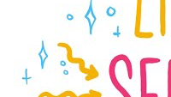

Slide 20
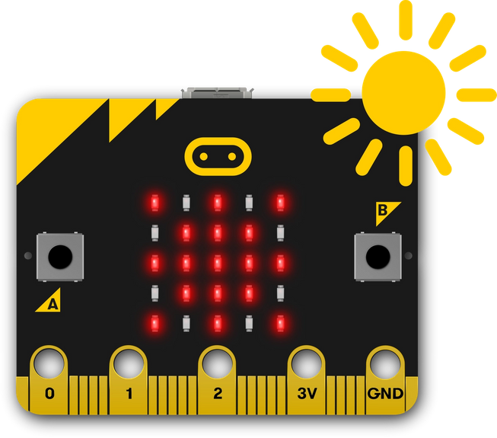
Step1: The Project Light Detector
What is it?
Turn the LED display into a sensor to make your micro:bit react to light
What do I need?
micro:bit (or MakeCode simulator) with USB
MakeCode or Python editor
Battery pack (optional)
A light source and something to cover the micro:bit with – your hand will do!

Slide 21
Step 2: How Does it Work?
As well as working as an output, the LEDs on your micro:bit can also work as an input device light sensor, measuring the amount of light falling on them.
This means that micro:bit programs can make different things happen depending on how light or dark it is.
The program uses an ‘if… else’ statement to show the sun image only if the light level is greater than (>) a certain level. This is known as selection – selecting when different things happen.

Slide 22
Step 2: How Does it Work?
Flash this program onto your micro:bit and shine a light source, like a torch, daylight or bright ceiling light on to the micro:bit, and you should see the sun appear.
Cover the micro:bit with your hand and the sun icon should vanish.
If it doesn’t work, try making the 100 number smaller to suit the lighting where you are.

Slide 23
New Coding Concept: If-Then-Else
Finish these sentences:
If it is raining outside, then I will wear _____________. Else, I will wear ____________.
If it is her 10th birthday, I will buy her a ______________. Else, if it is her 11th birthday, I would buy her a ________________. Else, I would just get her a ________________.
If he is not allergic to tacos, I will make ________________. Else, I will make _______________________.

Slide 24
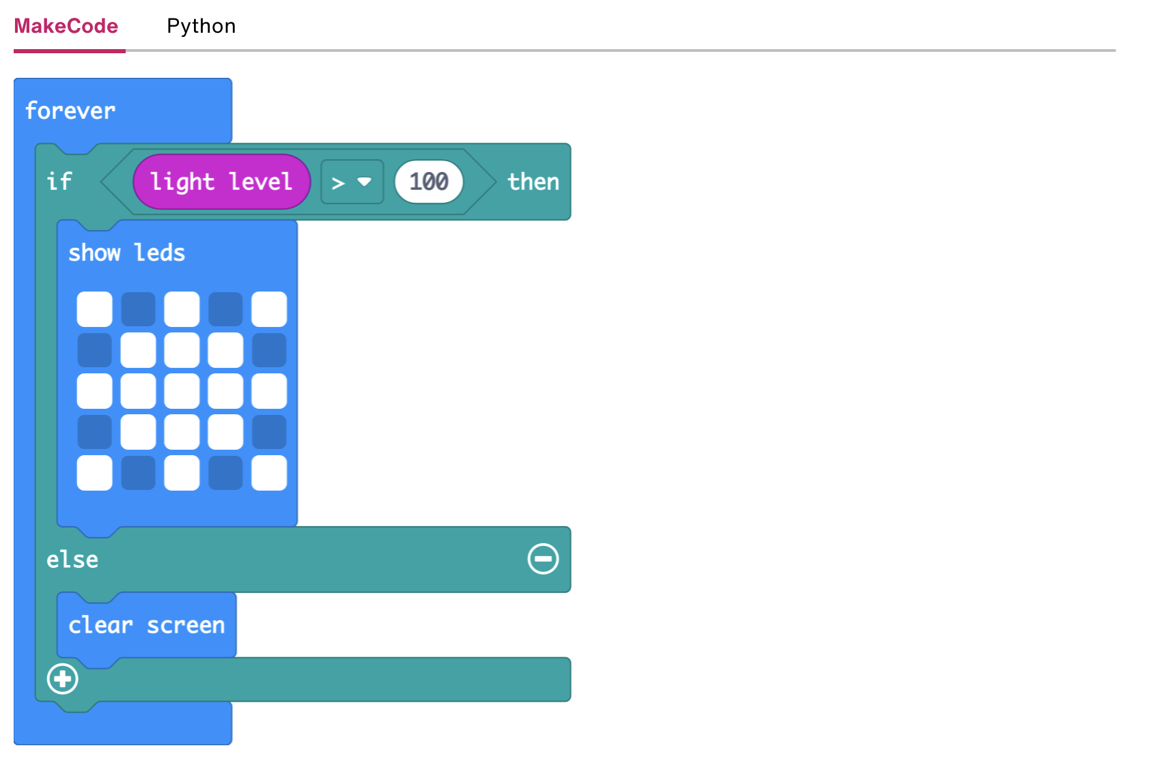
Step 3: Read the Code and Start Making!
Read the Code!
For as long as the micro:bit is on:
If the light level is greater than 100, then
Show this picture using LEDs.
Else,
Clear the screen.

Slide 25
Step 3: Read the Code and Start Making!
New Input: Light Level
Using the simulator, can you determine the light sensor’s level range?
If, Then, Else statements
If “something is true”, then “do this”.
Else, “do that”
“Something is true”
If a number > a target
If the given answer = the correct answer
Notes:
Build the code for the class in the MakeCode UI, so they can see how to use the if-then-else blocks.
Make sure students try the simulator to test the range of the light sensor.

Slide 26
Step 4: Share Your Creation!

Slide 27
Step 5: Improve It
Show an animated sun when light falls on your micro:bit.

Slide 28
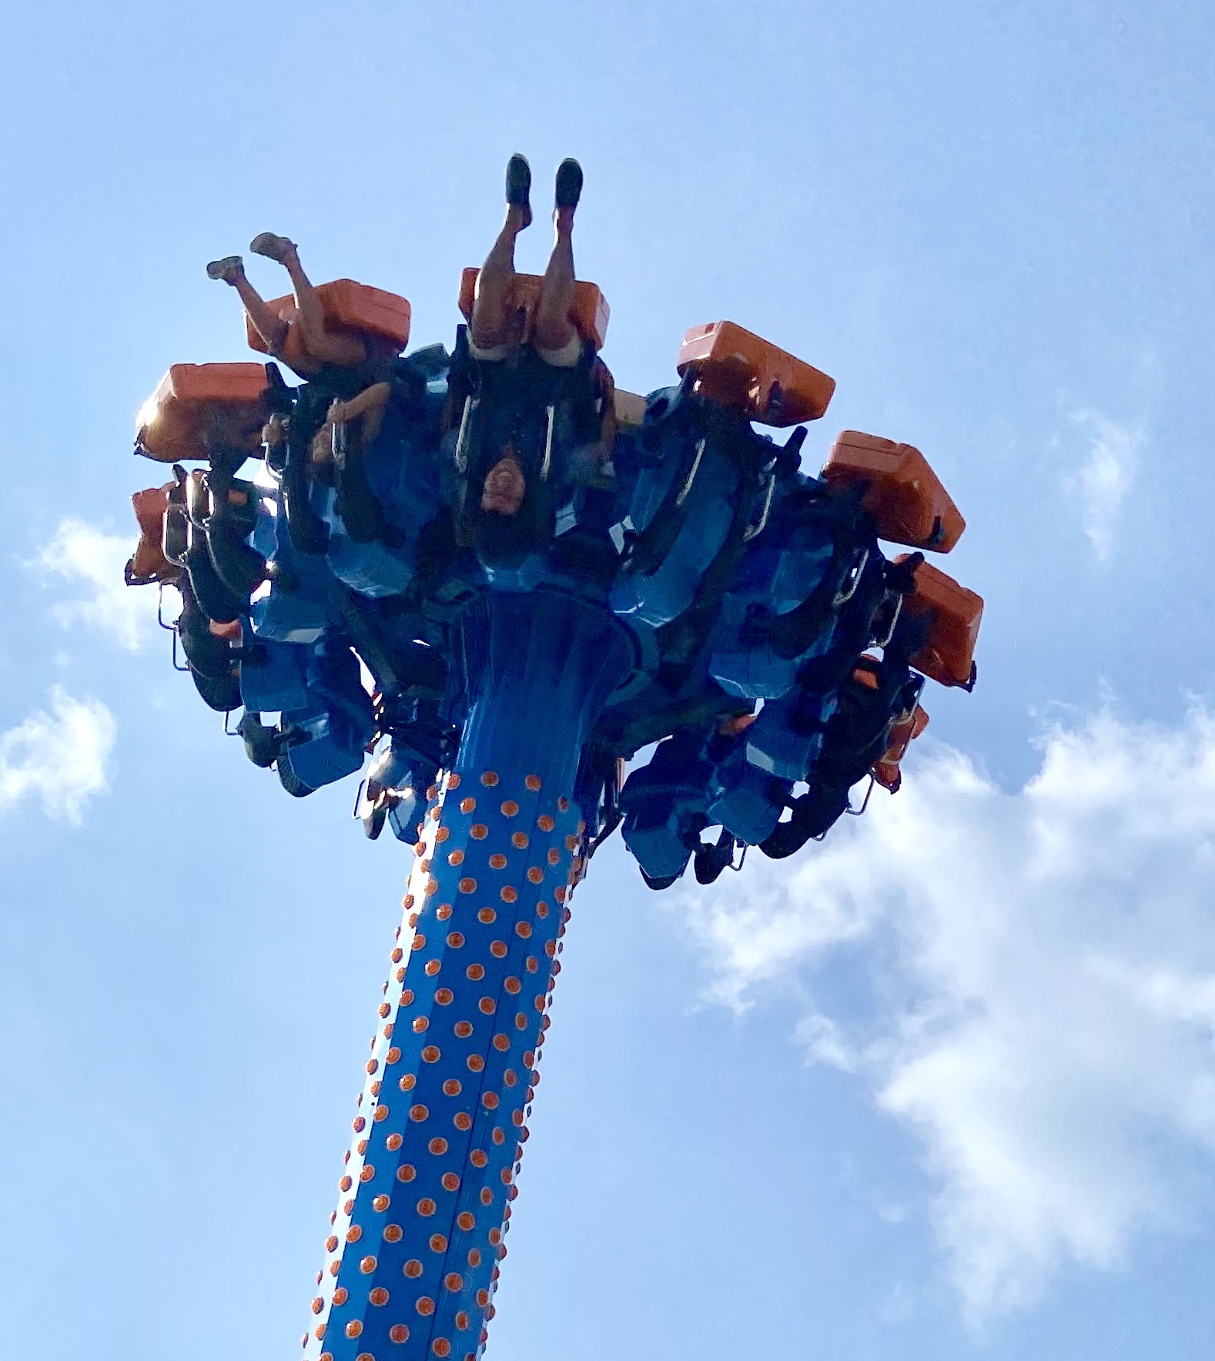
SKILL BADGE
Write Your Own Micro:Bit Program for Kids Afraid of the Dark
YOUR MISSION
Use your micro: bit to make a nightlight that turns on when it is dark!

Slide 29
PART III: Accelerometer Games
Let’s start making!

Slide 30


Slide 31
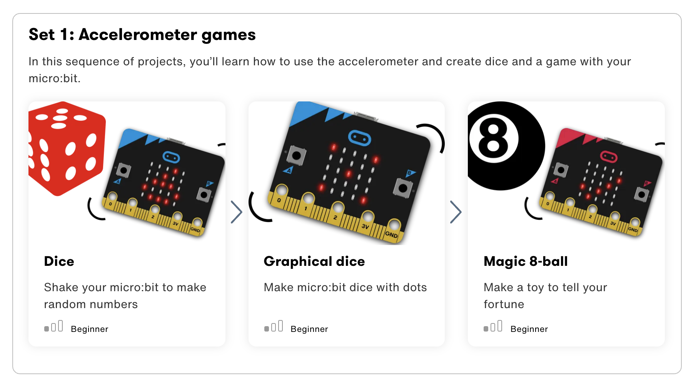

Slide 32
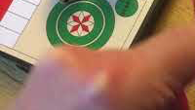
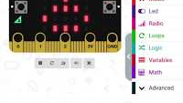
Step 1: The Project Random Numbers
What is it?
Shake your micro:bit to make random numbers
What do I need?
micro:bit (or MakeCode simulator) with USB
MakeCode or Python editor
Battery pack (optional)
Real dice (optional)

Slide 33
Step 2: How Does it Work?
Like the Get silly project this program uses the micro:bit’s accelerometer to make something happen when you shake it.
When you shake your micro:bit, the program selects a random number between 1 and 6 and shows it on the LED display.
It's really hard for computers to make truly random numbers because they’re machines that work precisely and regularly.
Make a tally chart of how often each number comes up. Are these numbers really random? Compare it with real dice.

Slide 34
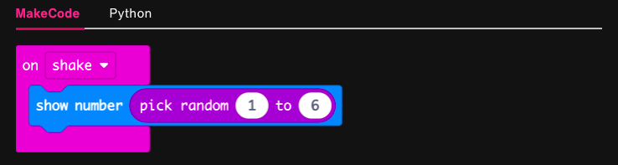
Step 3: Read the Code and Start Making!
Notes:
Introduce the math menu.

Slide 35
Step 4: Share Your Creation!
Notes:
On a board, if available, make a blank bar chart, with each student’s name across the bottom. Scale is 0-15.
Students take turn generating their random #s. First to reach 15 wins.

Slide 36
Step 5: Improve It
Make the number appear for a few seconds, then clear the LED display to save batteries.
Make it roll 2 dice. You can make a random number between 2 and 12, or you can make two random numbers between 1 and 6 and add them together.
Try both methods and tally how often each score occurs. Does it make a difference? Do some numbers come up more often than others?

Slide 37
Step 1: The Project Digital Dice
What is it?
A dice project that looks like a real die with patterns of dots instead of numbers.
What do I need?
micro:bit (or MakeCode simulator) with USB
MakeCode or Python editor
Battery pack (optional)
Squared paper for designing your own dice faces (optional)

Slide 38
Step 2: How Does it Work?
Like the Dice project this uses the accelerometer input to trigger the creation of a random number between 1 and 6 and show it on the LED display output when you shake the micro:bit.
Instead of showing a number, this program uses selection to show dots on the display to represent the numbers, looking like the dots on each face of real dice, depending on which random number was generated.

Slide 39
Variables
Are Your Friends!
Variables vs. Constants
A number variable could hold numerical data such as the year, the temperature, or you age.
A string variable holds text such as a person’s name, a password, or the day of the week.
A boolean variable has only two values: true or false.
A sprite is a special variable that represents a single dot on the screen and holds two separate values for the row and column the dot is currently in.
Notes:
Computer programs process information. Some of the information that is input, stored, and used in a computer program has a value that is constant, meaning it does not change throughout the course of the program. An example of a constant is your name, because it doesn’t change. Other pieces of information have values that vary or change during the running of a program. Programmers create variables to hold the value of information that may change. In a game program, a variable may be created to hold the player’s current score, since that value would change (hopefully!) during the course of the game.
Ask the students to think of some pieces of information in their daily life that are constants and others that are variables.
What pieces of information have values that don’t change during the course of a single day (constants)?
What pieces of information have values that do change during the course of a single day (variables) Constants and variables can be numbers and/or text.

Slide 40
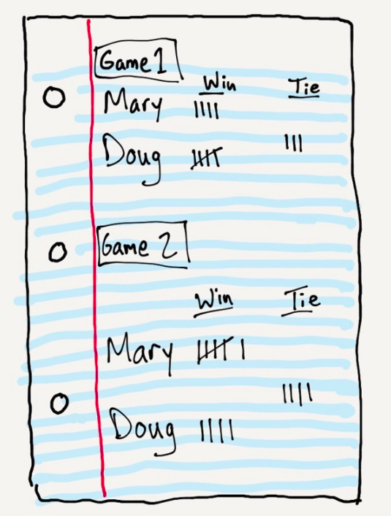
Variables
Are Your Friends!
Notes:
Ask the students what parts of the score sheet represent constants, values that do not change through the course of a gaming session.
Example: The players’ names are constants.
Ask the students what parts of the score sheet represent variables, values that do change through the course of a gaming session.
Example: The players’ number of wins are variables.

Slide 41
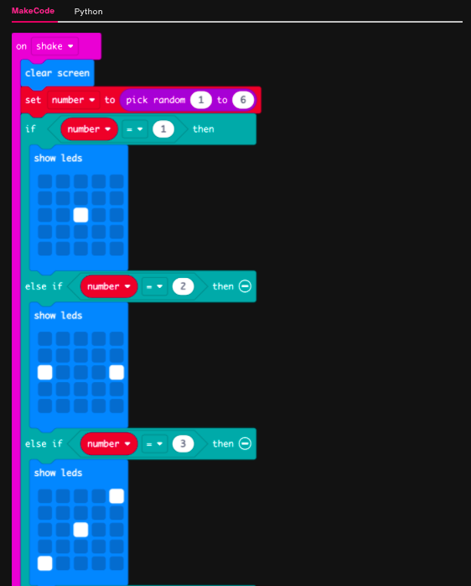
Step 3: Read the Code and Start Making!
Read the Code!
When the micro:bit is shaken:
Clear the screen
Set “number” variable to = a random number between 1 and 6.
If the randomly selected value for “number” = 1, then:
Display this picture with LEDs
Else if the randomly selected value for “number” = 2, then:
Display this picture with LEDs

Slide 42
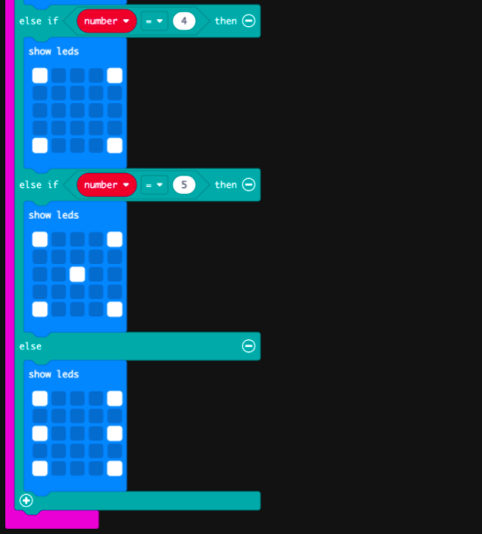
Notes:
Note that we are using the If-Else from the Logic Menu, rather than just If. Demonstrate live using MakeCode.

Slide 43
Step 5: Improve It
Make the display clear after a few seconds to make the batteries last longer and to make it clear when you have rolled two numbers the same.
Draw your own dot patterns to represent each number.
Make it roll higher numbers. How would you represent them on the 5x5 LED grid display output?

Slide 44
Step 1: The Project Magic 8 Ball
What is it?
Recreate a classic toy from the 1950s with your micro:bit and customise it to make it your own.
What do I need?
micro:bit (or MakeCode simulator) with USB
MakeCode or Python editor
Battery pack (optional)
Some questions to ask your micro:bit

Slide 45
Step 2: How Does it Work?
A Magic 8-ball is a toy invented in the USA in the 1950s. Shaped like an oversized pool ball, you ask it a question like ‘will I be rich and famous one day?’, shake the ball and one of 20 different answers randomly appear in a window. Answers can be positive, negative - or somewhere in between.
This program recreates a Magic 8-ball using the micro:bit’s accelerometer, its ability to make random numbers and its LED display output to show a tick for yes, a cross for no or a ‘meh’ face for ‘not sure’.
The program generates a random number between 1 and 3 then uses if… then… else… if… statements to make different symbols appear depending on the number. This is known as selection.
If the number is 3, it shows a tick for ‘yes’. If the number is 2, it shows a cross for ‘no’.
The program doesn’t need to check if the number is 1, because if it’s not 3 or 2, it must be 1, in which case it shows a ‘meh’ face for ‘not sure.’

Slide 46
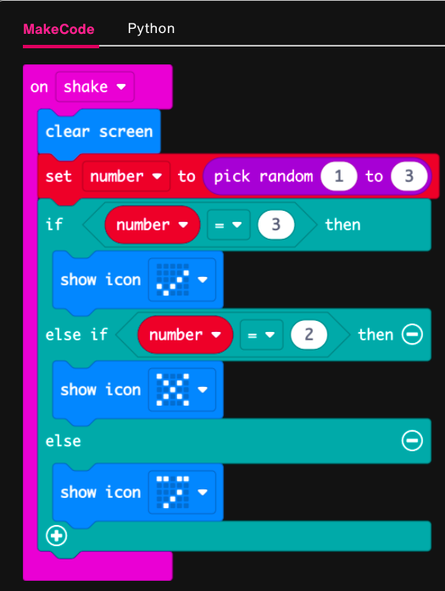
Step 3: Read the Code and Start Making!
Read the Code
When the micro:bit is shaken:
Clear the screen
Set “number” variable to = a random number between 1 and 3.
If the randomly selected value for “number” = 3, then:
Display this picture with LEDs
Else if the randomly selected value for “number” = 2, then:
Display this picture with LEDs
Else:
Display this picture with LEDs

Slide 47
Step 4: Share Your Creation!

Slide 48
Step 5: Improve It
Make the image vanish after a few seconds.
Make the micro:bit show different cryptic answers when you shake it, instead of pictures. It could say ‘I am not sure’ or ‘That remains to be seen’.
Here’s another way of making a Magic 8-ball using Python.

Slide 49
BREAK!
10 jumping jacks, please!

Slide 50
TIME TO PUT AWAY OUR MICRO:BITS!
Neat and tidy, please!
Let’s leave this beautiful room as lovely as we found it!

Slide 51
NEXT TIME
Playing with Even More Sensors!!

Slide 52
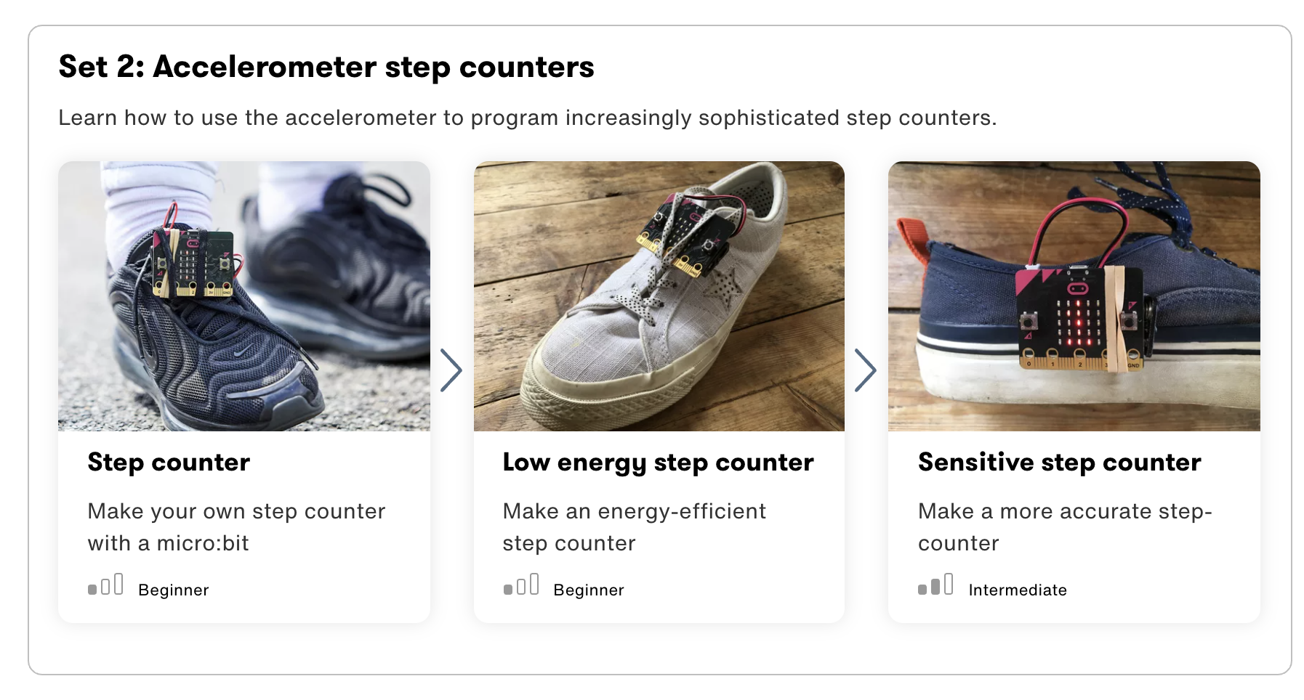

Slide 53

UNTIL NEXT TIME….
MicroMakers!
Slides and Script: Holly Krambeck (learningpython64@gmail.com)
Project Videos, Images, and Text: https://microbit.org/get-started

